Slide 1
MSRC trace 분석
김서진

Slide 2
논문 List
Adaptive policies for balancing performance and lifetime of mixed SSD arrays through workload sampling(MSST’16)
Server Trace Analysis for an Optimal Design of Solid State Drives(IJAER’16)
Write Off-Loading: Practical Power Management for Enterprise Storage (FAST’08)

Slide 3
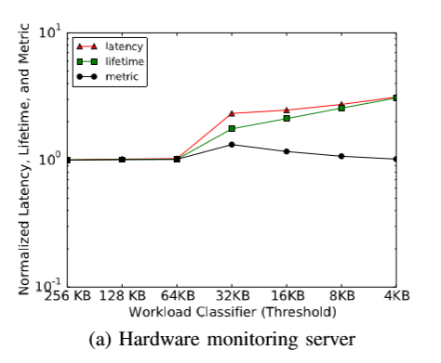
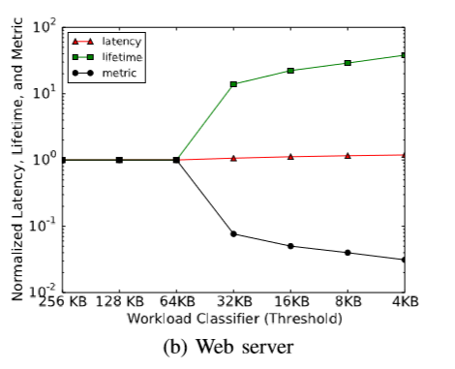
해결해야 하는 문제
첫번째 논문에서 MSRC trace workload중 webserver와 hardware monitoring server를 사용한 이유는 무엇인가?
둘의 차이점이 무엇인가?
결과 그래프가 이렇게 나오는 이유는 무엇인가?
왜 Request size based caching policy에서 두 workload를 사용해서 실험을 했는가?

Slide 4
Write off-loading
Motivation
Energy problem: Saving power in storage systems is difficult.
Most of disk’s energy just to keep spinning
Flash is expensive(not now)
Need to spin down disks during idle period

Slide 5
Real workloads
Diurnal, weekly patterns
Idle periods
Write-only periods: Reads absorbed by main memory caches.
Reason: main-memory caches are effective at absorbing reads but not writes. [Measurements of a distributed file system, SOSP’91]
Suggest: Write-off loading
Convert write-only to idle
Spin down during idle period

Slide 6
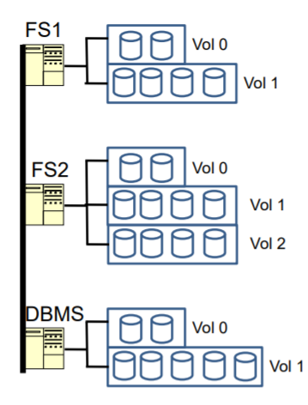
Write-off loading
Implementation: at the block level, transparent to file systems and applications running on the servers.
Applicable to
10s to 100s of disks
Heterogeneous servers
RAID volumes
High-end disks

Slide 7
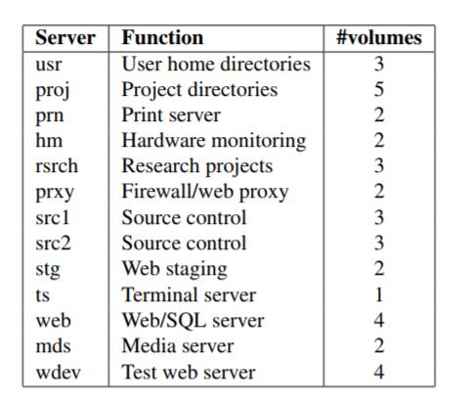
About MSRC trace
Block-level traces from an enterprise data center, which motivates write off-loading
Less I/O intensive than TCP benchmarks

